Slide 1
The Battle of Neighbourhoods
Applied Data Science Capstone
By:
Gopal Sahu

Slide 2
Agenda
Problem Statement
Data collection
Methodology
Results

Slide 3
Problem Statement:
New York is one of the cities where a huge number of Indian reside.
With growing number of Indian/Sub-continent population, the number of restaurants is not sufficient or very sparse across the city.
Also people from various other countries like to try out authentic Indian food which is very unique.
An Indian food chain sees this as an opportunity and wants to expand outside India and wants to find out the suitable areas for opening restaurants. The problem statement is to find recommended place to open new branch of the food chain.

Slide 4
Data Collection:
First I will get the location data of New York and its neighbourhood. Then I will use these location data from foursquare to get Indian Restaurants in the neighbourhood.
Neighbourhood location co-ordinates from NYU (JSON)
Google Maps data for venues
Foursquare location data of various restaurants (JSON)
(Obtained from foursquare.com API calls)

Slide 5
Methodology:
The whole methodology remains same as in New York venue exploration.
First, get the borough and neighbourhood data from NYU site.
Get the location data from those neighbourhood and places from Google Maps.
Search for various venues of that neighbourhood.
Cluster the neighbourhood based on popular places.
However the analysis will include the category of venue in foursquare search for Indian restaurants.
Once the neighbourhood is marked with their similarities, the clusters where the first 10 common venue include restaurants are suitable for opening new restaurant
Also the places where there are café’s and theatres , that has potential for take away shop for the restaurant.

Slide 6
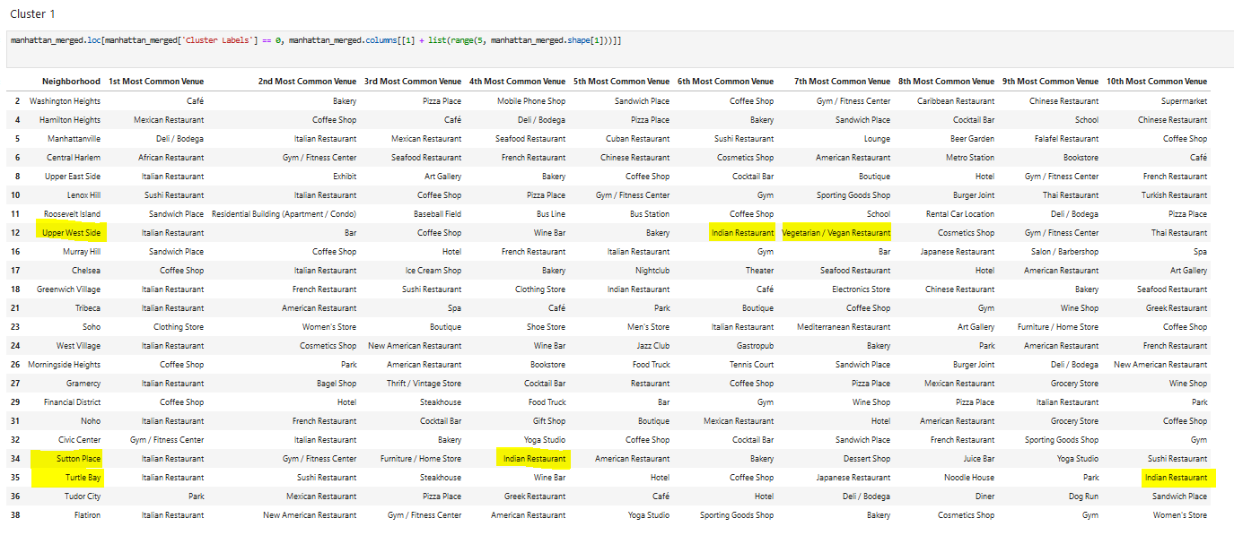
Results: The Yellow marked neighbourhoods are suitable for Indian restaurants.

